Slide 1
Fall Monitor Presentation
Ardienne Salas - 100655557
Jackson Landry - 100302201
Kaamran Minhas - 100593277

Slide 2
TOC
Introducing: The Fall Monitor
Understanding the problems
Project objective
Target audience
Market trends
Cycle diagram

Slide 3
Introduction
Currently, the government is searching for a fall monitor system that aims to lessen the number of casualties that occurred from falling for seniors (aged 65+)
The appliance must be able to detect when its user has fallen down and to contact necessary emergency services if required.
When a fall is detected and the user does not respond within a given time frame, the product should alert an agent who will then contact emergency services and provide the users medical information, precise location, and the time of the fall.

Slide 4
Understanding the problems
01
The device must be able to accurately detect when a user has taken a serious fall. The use of gyroscopes and accelerometers will allow for the device to determine serious falls from less serious ones.
02
The device must contact an agent in a time no more than 30 seconds after the fall has occured to ensure a timely response from emergency services.
03
Battery life of the device must be a minimum of 24 hours before it must be charged so that the user is not in danger of having their device dying frequently.

Slide 5


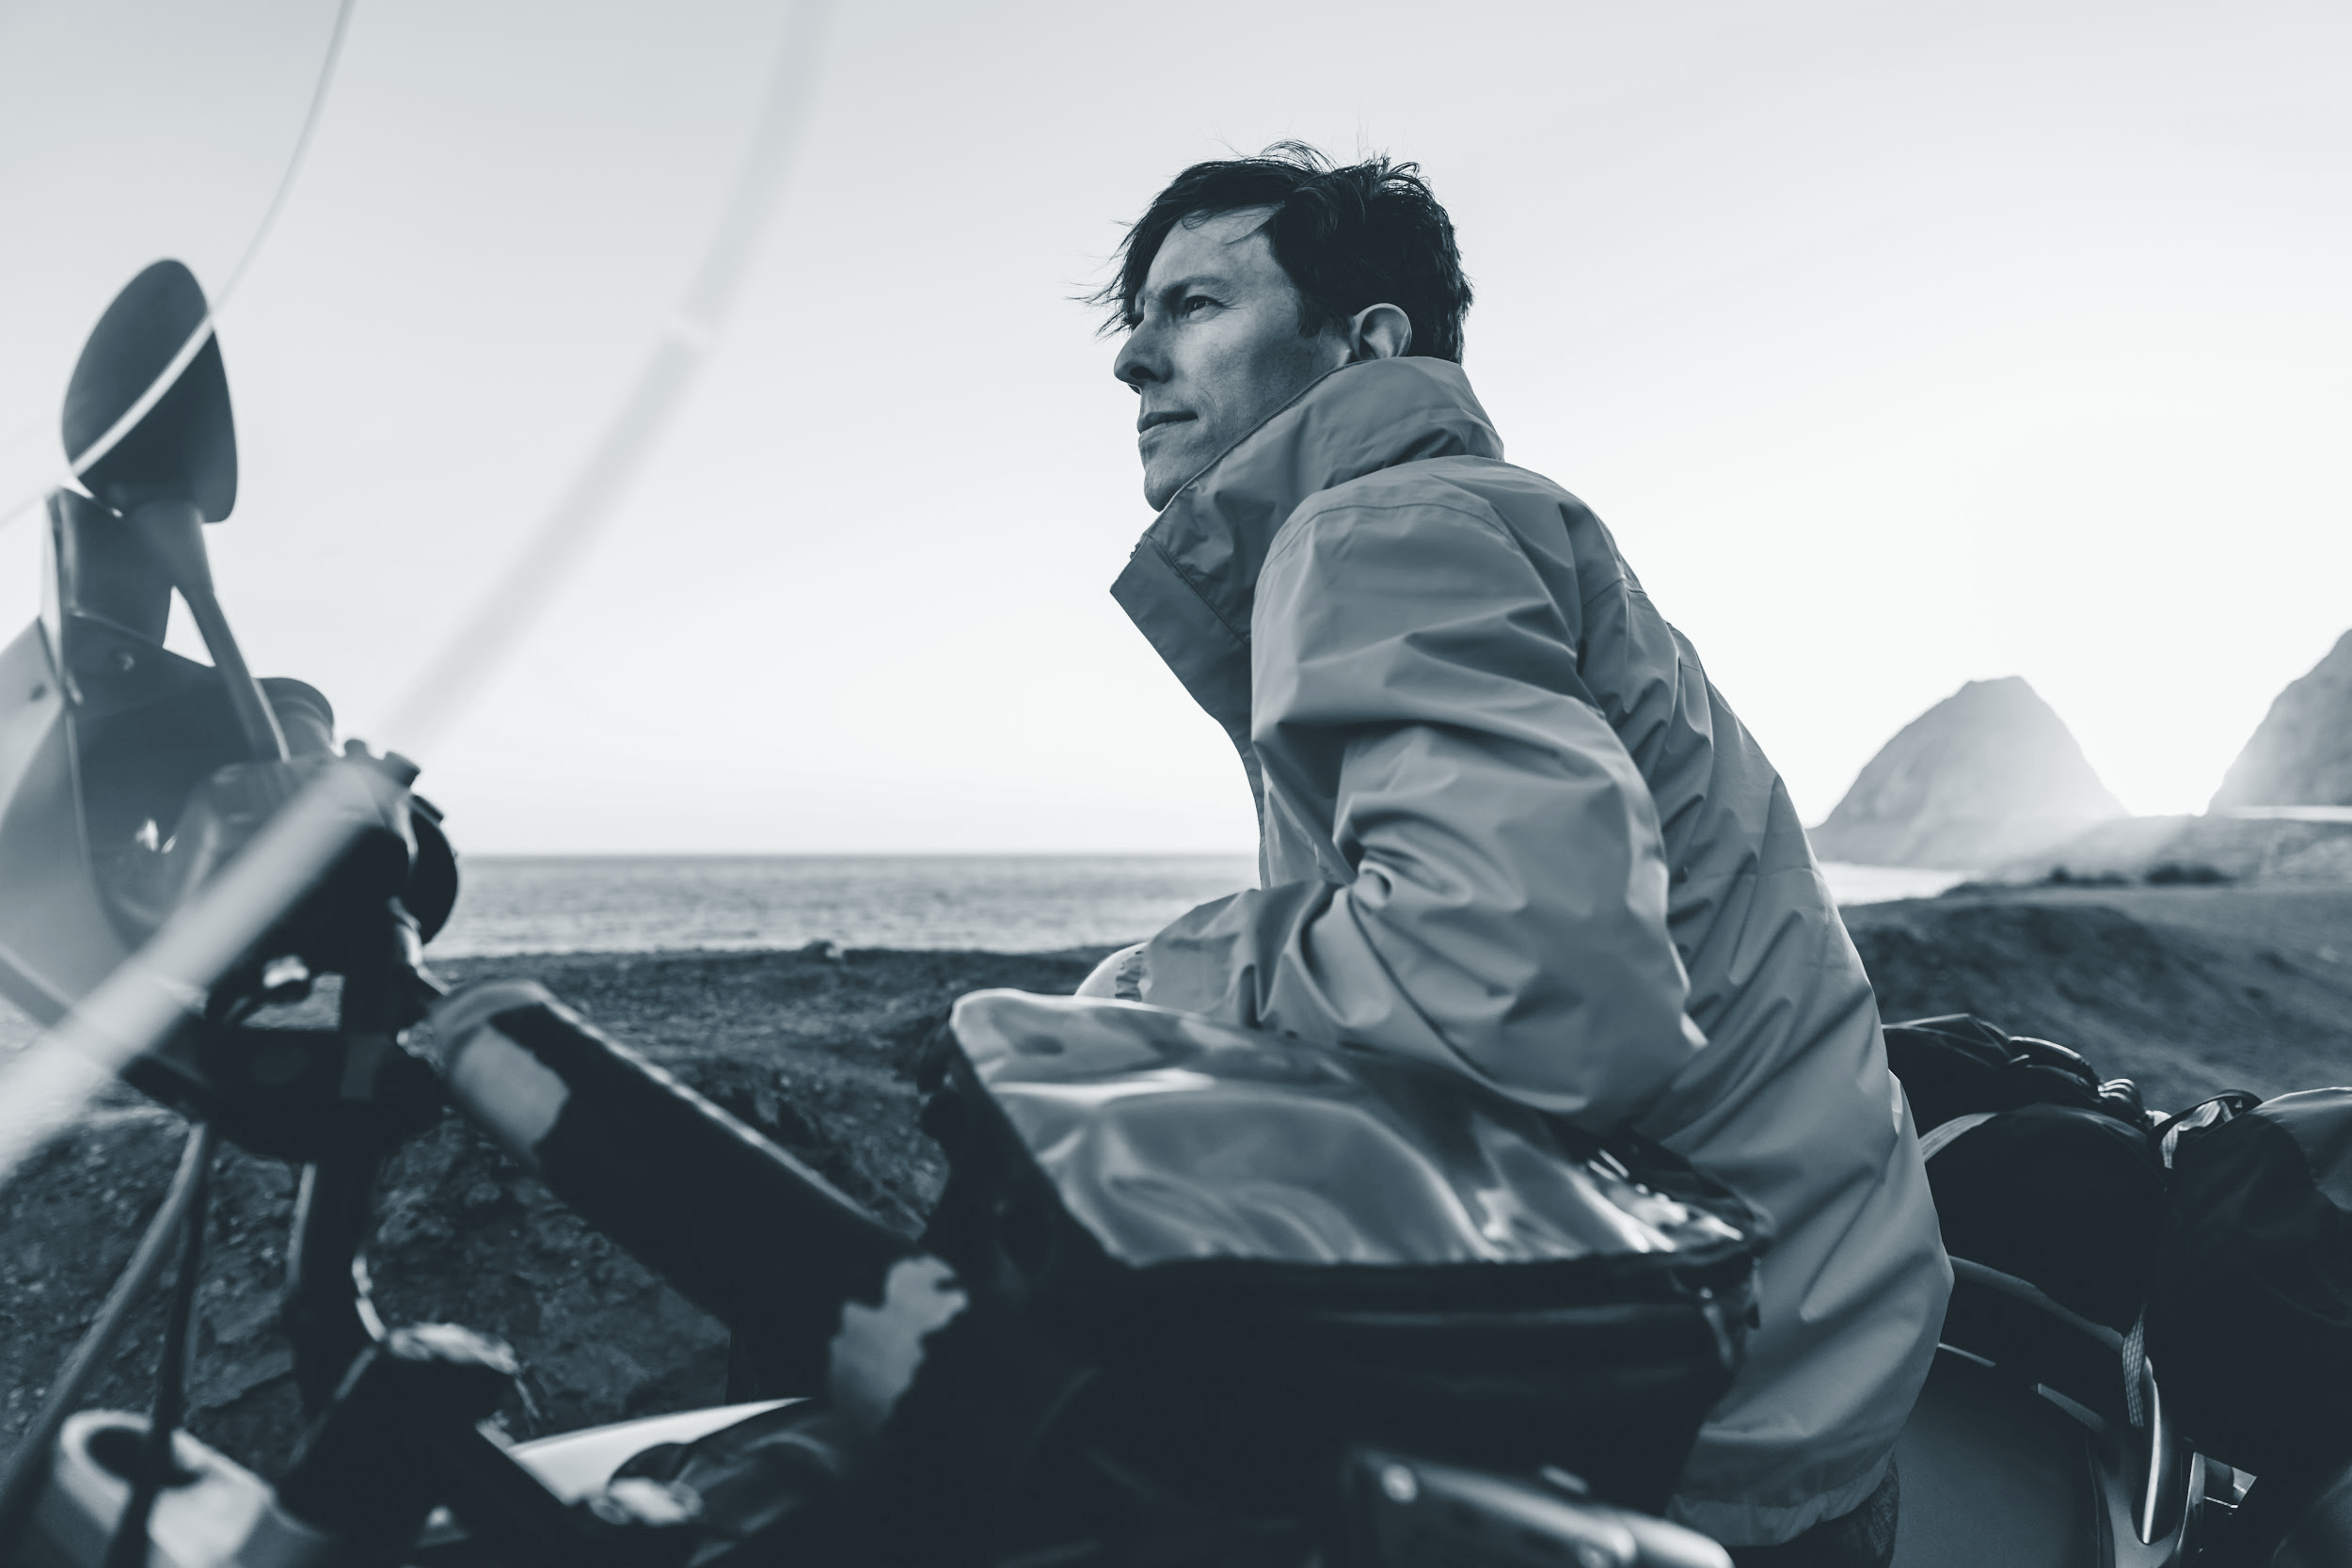
Target audience
The target audience for the product is seniors who are more at risk for life threatening falls. Ideally the product will be offered either for free through insurance or at a reduced rate to people who are considered more at risk for serious falls.

Slide 6
Risks
Lack of effort from the employees which can result in a lack of productivity and a delayed release of the product. The counter measure we will implement for this will be increasing the strictness in the hiring process in order to find the best possible employees for each respective position. The interview and hiring process will involve high intensity programming situations where the applicants will be tested to ensure they are prepared for the job.
The customer may not be satisfied with the final product. The counter measure we will implement for this will be to hold an open beta during the user testing portion of our development process. After this we will collect feedback from the users and re-analyse the scope of the project to ensure that it fits the user’s wants and needs.

Slide 7
Objectives and Measures of Success
Deliver a working product within the given time frame. This will be successful if we can produce working software in 3 months, and full production finished within 9 months.
A website should be created alongside the product for user registration. The website should be finished on the 9 month timeline of the project.
The device will be considered a success if we are able to sell upwards of 10000 units within the first year of release.

Slide 8
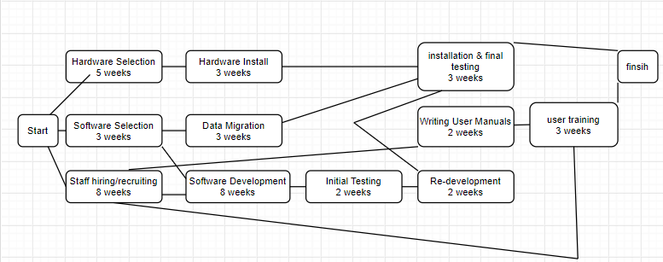
Activity Diagram

Slide 9
Resources
Hardware:
Gyroscope: The gyroscope is used to measure or maintain orientation or angular velocity. This means it will be efficient in sensing falls due to the rapid change in angular velocity and momentum.
Accelerometer: An accelerometer measures changes in gravitational acceleration. Since the accelerometer can sense changes is gravitational acceleration, it is efficient in being able to detect a fall, due to the user’s change in acceleration.
Software:
Online website for registration with the product. The website should include user registration and device information. For user registration, the user should input medical information as well as an emergency contact in case of a fall.
Implement a cloud server which will be used to store the information of the users.
The device will use Bluetooth to communicate between the sensor and communication module. Bluetooth will be used because it will allow for easier connection to other devices such as the mobile phone of the user. Using low energy Bluetooth will also allow for the battery to be optimized.

Slide 10
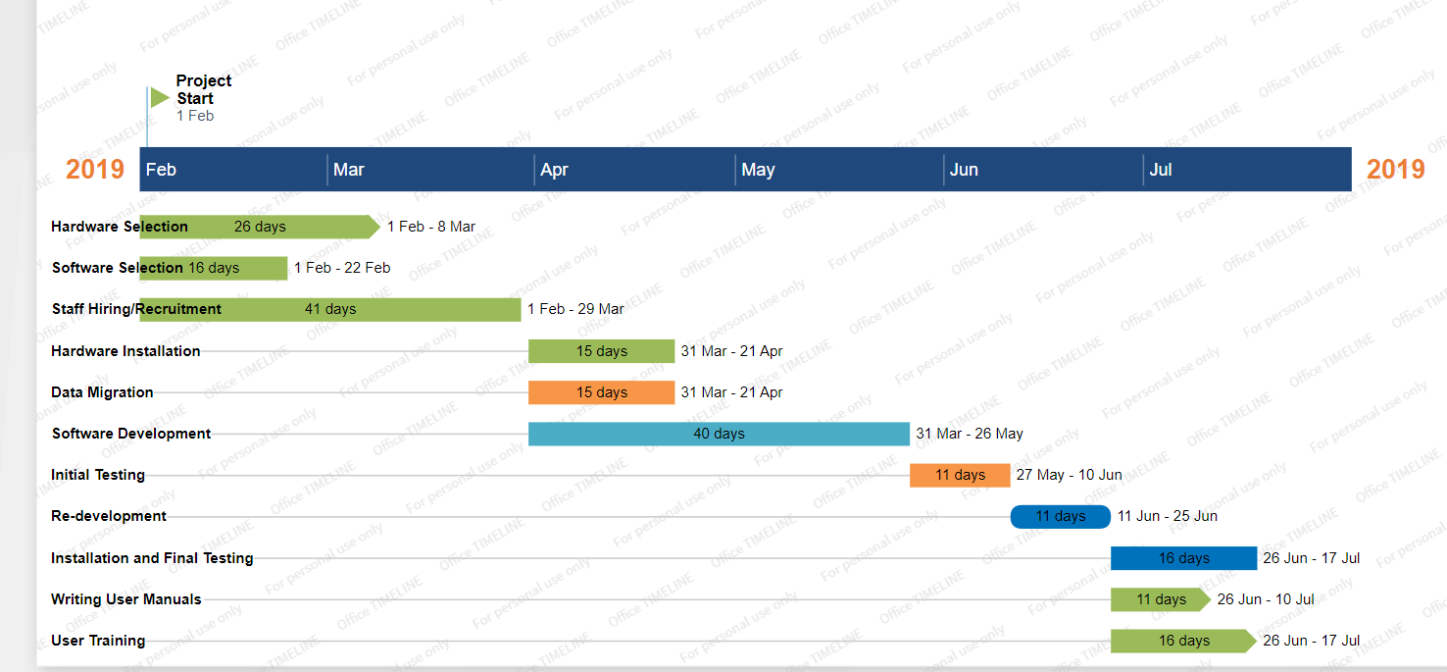
Gantt Chart

Slide 11

Thank you!
Questions?

